Slide 1
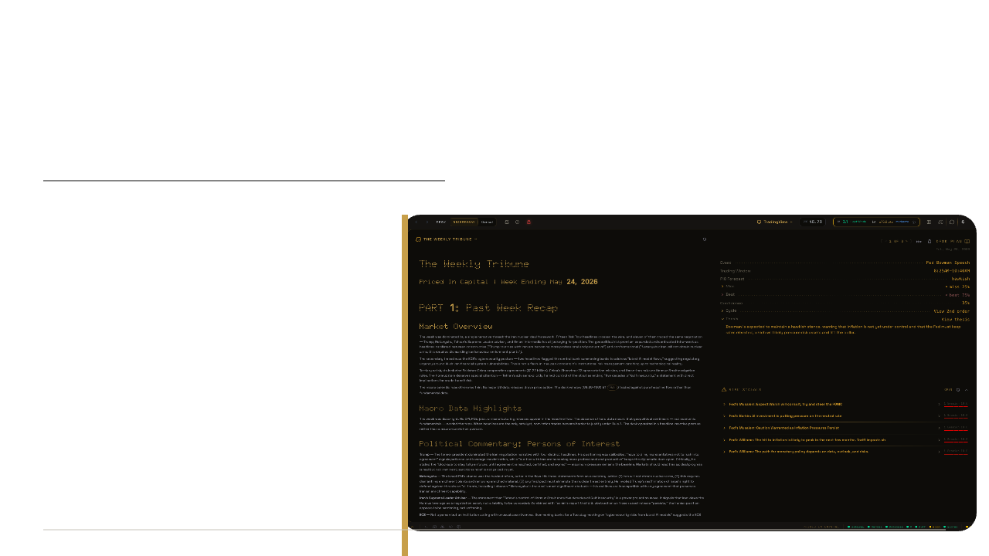
FINTHEON
01
Investor Draft | July 2026
FINTHEON
The agentic
Analyst Desk
for active traders.
Built past MVP. Ready for the guarded terminal layer.

Slide 2

FINTHEON
02
The Problem
TRADERS DO NOT LOSE
FOR LACK OF SCREENS.
Decision quality breaks when context, risk, and behavior split apart.
Market Data
Market Noise
Trader State
Scarce
Charts
Quotes
Level 1
Economic calendar
Headlines
X and Discord
Alerts
Hot takes
Bias
FOMO
Tilt
Stale conviction
DECISION
QUALITY

Slide 3

FINTHEON
03
Why Now
THE NEXT
WORKSTATION
IS BUILT FOR
DECISION QUALITY.
01
Active Futures
02
Prop-Firm Discipline
03
Always-On AI Agents
04
Constant Event Risk

Slide 4
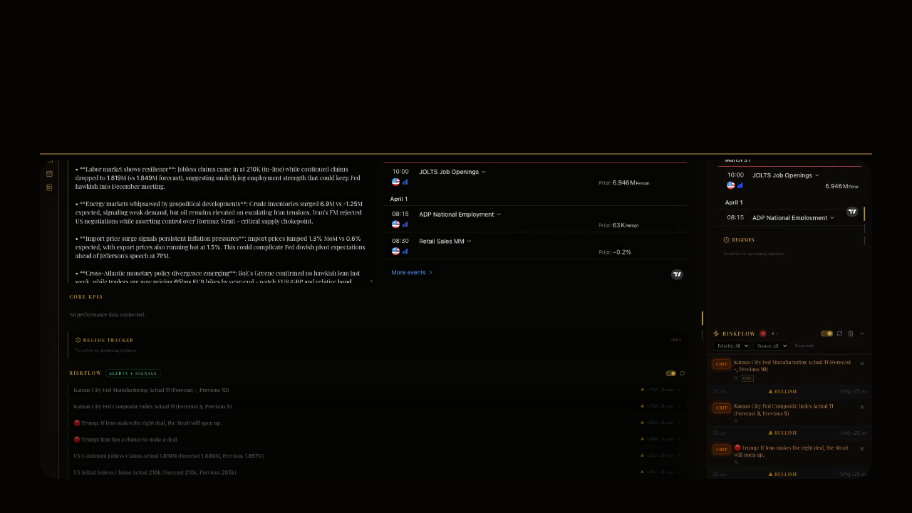
FINTHEON
04
The Product
ONE DESK. ONE DECISION LOOP.
Risk
Narrative
Dissent
Synthesis
Behavior
Review

Slide 5
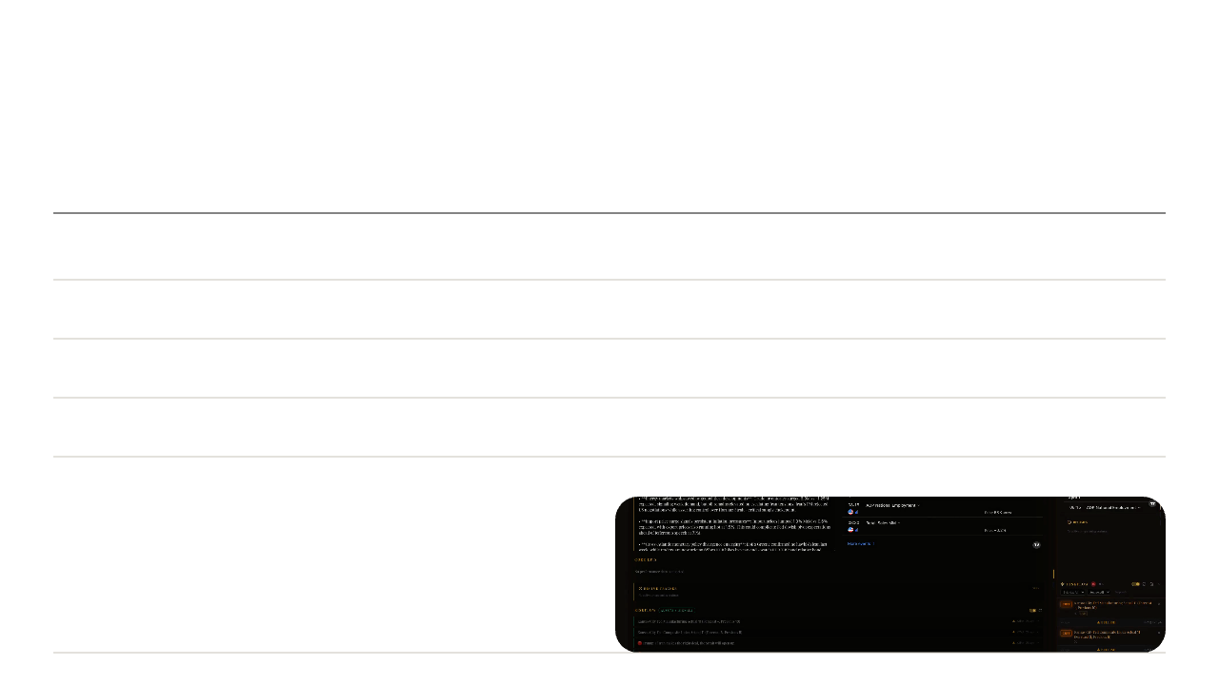
FINTHEON
05
Product Proof
PAST MVP.
Release-ready across desktop, web, mobile, cloud, billing, and updates.
Ship
Electron desktop | Web | Mobile/PWA | Cloud diagnostics
Decide
RiskFlow | NarrativeFlow | Consilium | Arbitrum
Coach
Harper/CAO | PsychAssist | Performance | Briefs
Sell
Checkout | Billing portal | Entitlements | Locked states
Rithmic Service Scaffolding + Guarded Gateway Design Also Exist
Roadmap infrastructure, not a claim that live trading is enabled.

Slide 6

FINTHEON
06
Wedge and Expansion
FUTURES FIRST.
Start with traders who already feel the cost of bad decisions.
Now
Next
Scale
Expand
Serious Futures + Prop Traders
Options + Event Traders
Small Desks + Communities
Professional Desks
Session context, invalidation, risk discipline, and behavior-aware guardrails.
Catalysts, macro events, positioning, volatility, and narrative drift.
Shared briefs, source trails, decision records, and one risk language.
Agentic memory, policy control, audit trails, and terminal-grade data workflows.

Slide 7

FINTHEON
07
The Beachhead Workflow
BEFORE
AFTER
What Changed?
What Did the Market Teach?
What Matters?
What Did the Trader Repeat?
What Invalidates the Idea?
What Belongs in Memory?
What Should I Not Chase?
What Changes Next Session?
Brief
Session Support
Review
Memory
The session becomes a learning loop, not a collection of disconnected alerts.

Slide 8

FINTHEON
08
Business Model
$0
Free terminal, paid depth
Core plans
Professional plans
Free Terminal shell + delayed data
Prop Firm $29/mo | $290/yr
Desk $150/mo for 2 seats
Consul $199/mo | $1,990/yr
Journalist $49/mo | $490/yr
Analyst $100/mo | $1,000/yr
Firm $25k/yr minimum | custom
Founder lifetime 3x annual | cohort only
Value-first pricing
Conversion logic
Free terminal access. Paid conversion follows data freshness, intelligence depth, AI/API usage, automation, and collaboration.
Free: shell, delayed data, basic briefs, onboarding.
Paid: research, intelligence, automation, collaboration.
Real-time conditional. Rithmic first. Crypto excluded.
Annual = 10x monthly. Founder lifetime = 3x annual. AI/API, exchange, and high-cost integrations bill separately; entitlements split by role, freshness, AI/API, seats, collaboration, provider, and lifetime.

Slide 9

FINTHEON
09
Revenue Scenarios
$1.2M
Analyst-led core ARR
1,000 Analyst users at $100/month
Desk and Firm add ACV.
Analyst Users
MRR
ARR
100
$10k
$120k
250
$25k
$300k
500
$50k
$600k
1,000
$100k
$1.2M
Illustrative core-plan scenarios, not forecasts. Excludes Desk, Firm, annual prepay, founder deals, partner revenue, and separately billed usage.

Slide 10
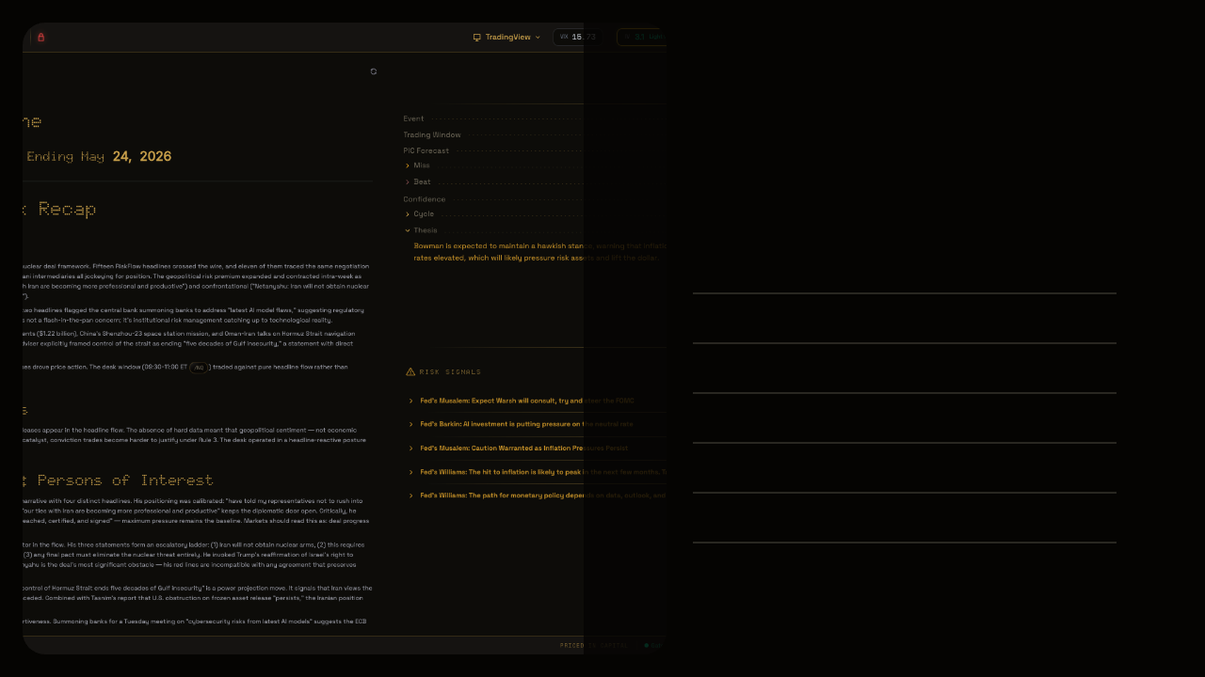
FINTHEON
10
Defensibility
THE MOAT
IS THE LOOP.
01
Scored Market Risk
02
Narrative Memory
03
Agentic Dissent
04
Behavior Feedback
05
Performance History
06
Better Calibration
Any product can call an LLM. Fintheon compounds market context, decisions, feedback, provenance, and memory.

Slide 11
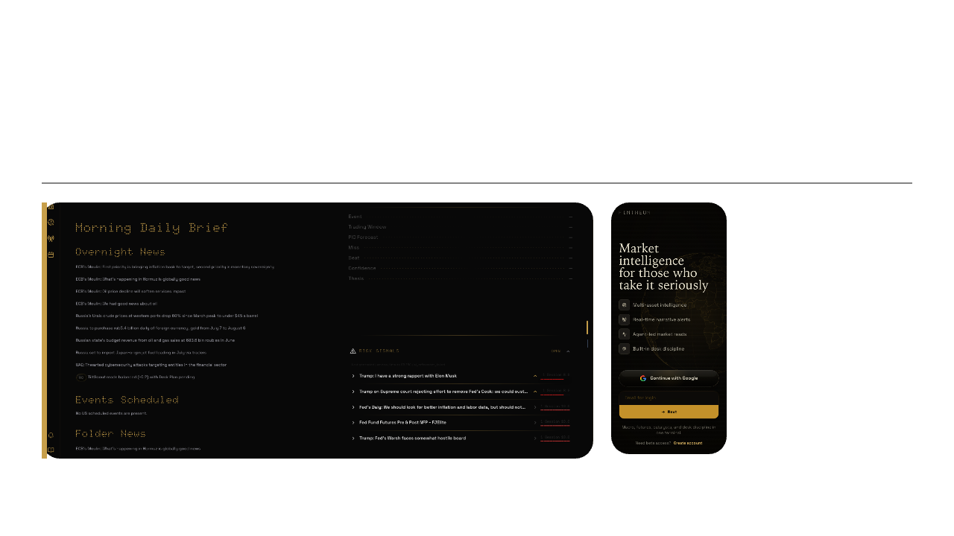
FINTHEON
11
Release Proof
THE DESK IS LIVE
ENOUGH TO MEASURE.
OK
3 Surfaces
Desktop
Web
Mobile / PWA
Cloud diagnostics
Release + updater pipeline
Billing + entitlements
Live API, diagnostics, and public preview rechecked July 9, 2026.

Slide 12

FINTHEON
12
Terminal Expansion
Live Only After All Gates Pass
GUARDED
TERMINAL
01
Paid entitlement
02
Terms + trading-risk consent
The next layer is not click-to-trade. It is controlled market access.
03
Identity verification
04
Broker + market-data authorization
01
Level 2 / Depth
05
Rithmic capability check
02
Live Ticks + BBO
03
Account + Positions
06
Paper / dry-run first
04
Orders + Fills
07
Allowed account + size + kill switch
05
Auditable Dry-Run Intent
Roadmap. Fintheon is not currently claiming broker, CTA, adviser, or autonomous-execution status.

Slide 13

FINTHEON
13
Startup Costs + Use of Funds
THE RAISE FUNDS TRUST,
NOT AN MVP.
$1.25M
Post-Money SAFE
12-Month Planning Scenario
35%
Terminal + Data Integration
$437.5k
Modeled Hard-Cost Reserve
25%
Security + IDV + Audit
$312.5k
$180k-$420k
20%
Product + Release + Support
$250k
before payroll
12%
Go-To-Market
$150k
Security + SOC 2
Legal + consent walls
Rithmic + exchange data
Infrastructure + observability
08%
Legal + Vendor Reserve
$100k
Vendor pricing and regulatory scope can move materially. Sources: Stripe Identity, Vanta, AMP Futures, CME Group 2026 fee list.

Slide 14

FINTHEON
14
The Ask
WE BUILT
THE DESK.
NOW FUND
THE TERMINAL.
$1.25M
Capital
Partners
Fund security, IDV, legal gates, terminal engineering, and beta distribution.
Rithmic/broker access, market data, and serious pilot desks.
Post-Money SAFE
01
Terms + IDV Wall
02
Rithmic Beta
03
Level 2 Dry-Run
04
Guarded Live Gate
Planning draft. No claim of guaranteed performance, brokerage, investment advice, or currently enabled autonomous live trading.

Slide 15
FINTHEON
15
Market Expansion
The market is already
cross-asset.
Fintheon starts where the workflow is strongest, then carries its decision layer across equities and options.
12.2B
15.2B
28.1M
Equity shares per day (2024)
Listed options contracts (2025)
CME futures + options per day (2025)
+26% YoY
+6% YoY
The activity proves a large, liquid market. It does not by itself equal Fintheon revenue.
Sources: SIFMA 2025; Cboe 2025; CME Group 2025 market statistics.

Slide 16
FINTHEON
16
Ownership Strategy
Partner rails
The owned layer
survives every market.
Access is integrated.
The intelligence stays ours.
Fintheon owns
Decision context
Risk and behavior
Narrative memory
Agent orchestration
Audit + entitlement logic
Brokerage custody
Order routing + settlement
Exchange and Level 2 data
Futures clearing / FCM
Identity vendors
One product layer, multiple market adapters.
Execution and custody remain partner-led until legal scope is confirmed.

Slide 17
FINTHEON
17
Post-Money SAFE
A pre-seed round with
clean ownership math.
Post-money SAFE terms keep early financing simple while preserving room for the terminal and cross-asset expansion.
Anchor check
Full round target
$500k
$6.25M cap
$1.25M
$8.33M cap
8% post-money ownership
15% target dilution
The cap is a financing term, not a claim that the company is already worth that amount.
Capital funds
Security, identity verification, consent walls, Rithmic + Level 2, product hardening, and pilot distribution.
Final terms depend on cap-table review, investor demand, and counsel.

Slide 18
FINTHEON
18
Pre-Seed Milestones
The round funds
the next proof.
The retained upside
One decision layer.
Multiple market adapters.
12-month milestones
Fintheon owns the context, memory, risk, behavior, and workflow layer while regulated partners provide market access.
01
Trust gates
02
Futures terminal
Investors fund the proof. The company keeps the platform.
03
Cross-asset pilots
04
Retention + conversion proof

